Slide 1
Fair Division
Prof. Toby Walsh
Chief Scientist@AI Institute
UNSW Sydney
Notes:
I'll be honest with you, for most of the last 30 years, very few people have cared about what I do.
That's because I've spent the last 30 years trying to build AI
And for most of those 30 years, building AI, building machines that do tasks that require us humans to think seemed so remote, you heard little about AI other than in futuristic movies.
But now you can't open a newspaper without reading multiple stories about how AI is starting to succeed and take over some new task in our lives.

Slide 2
Overview
09:00 – 09:40 | Introduction to Fair Division | Toby Walsh
09:40 – 10:20 | Fair Division with Subsidy | Mashbat Suzuki
10:20 – 10:30 | Break
10:30 – 11:10 | Fair Division of Mixed Goods | Xinhang Lu
11:10 – 11:50 | Matching | Haris Aziz

Slide 3
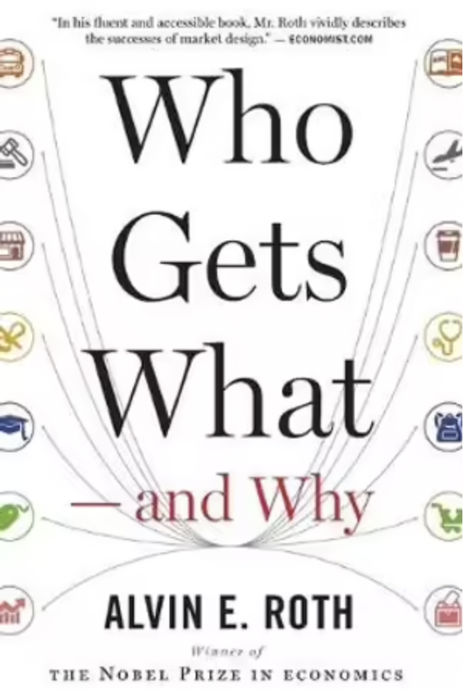
Fair division
Dividing one (or more) resources among two (or more) people so that each person receives their fair share
Roth and Shapley were winners of 2012 Noble prize
…

Slide 4
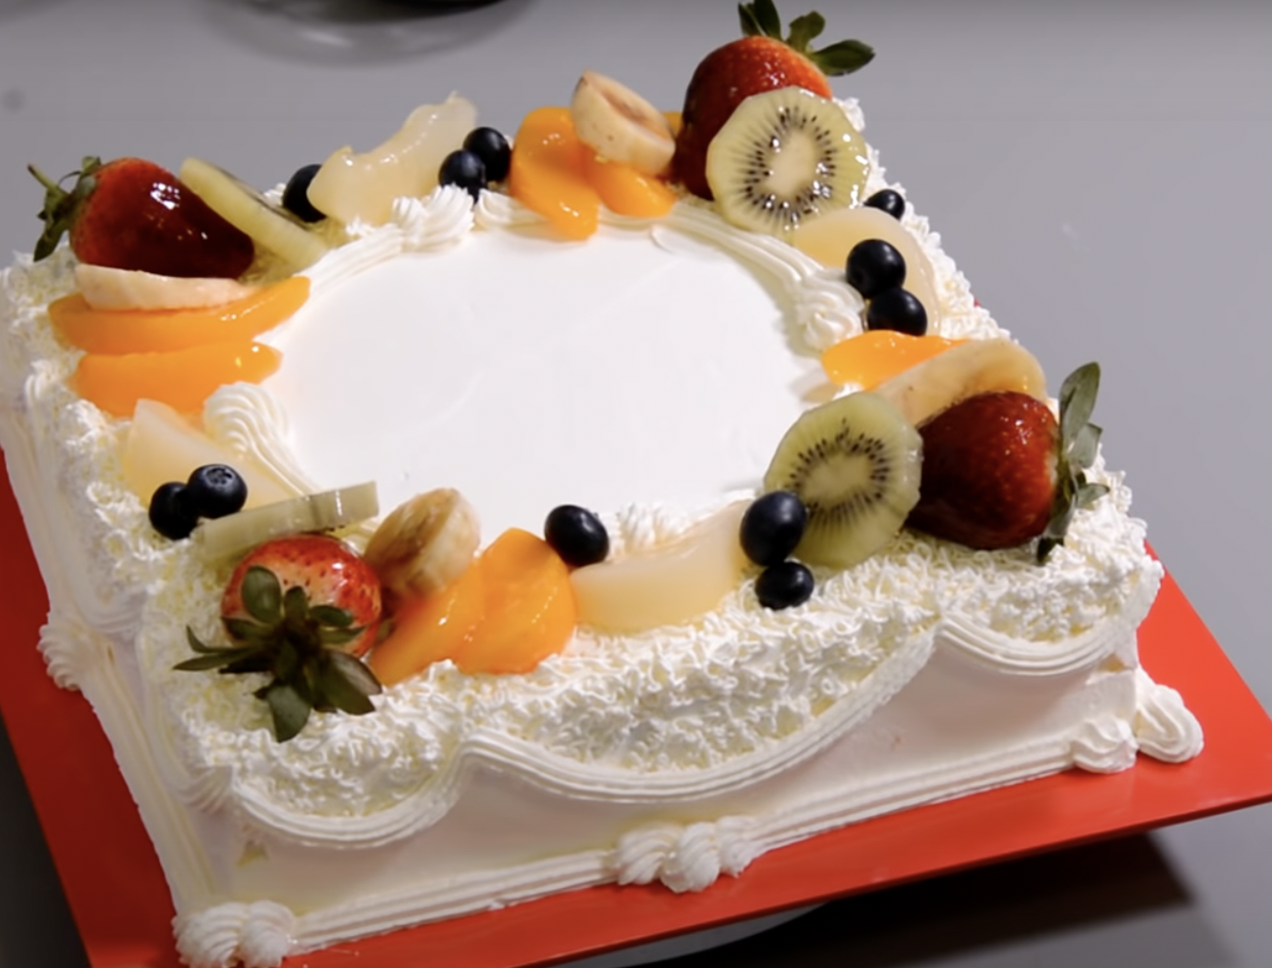
Cake cutting
Divisible resource
Agents have different preferences for different parts of the cake
Sharing time/disk space/… on a supercomputer
Sharing time on a telescope
…

Slide 5
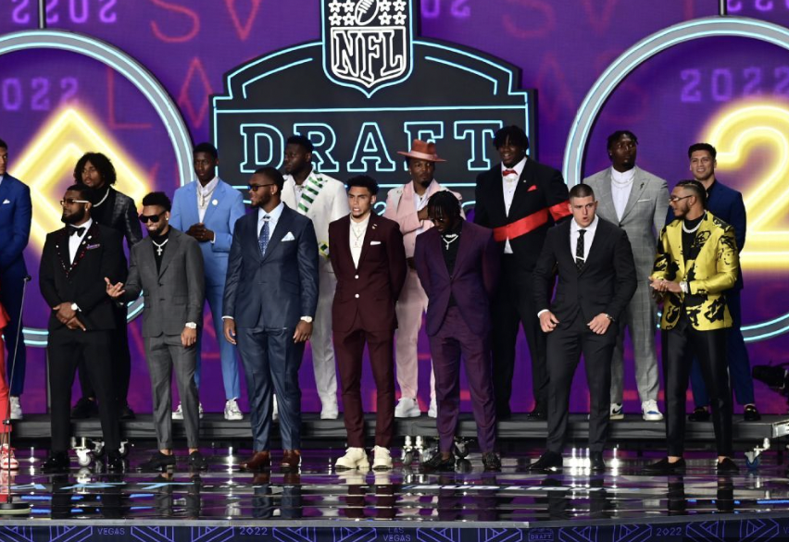
NFL Draft
Dividing players up between teams
Indivisible resource
Dividing assets after a divorce
Sharing an estate
…

Slide 6
Split a taxi fare
Can we fairly and efficiently split the taxi fare in a share taxi?
Divisible chore (taxi fare)

Slide 7
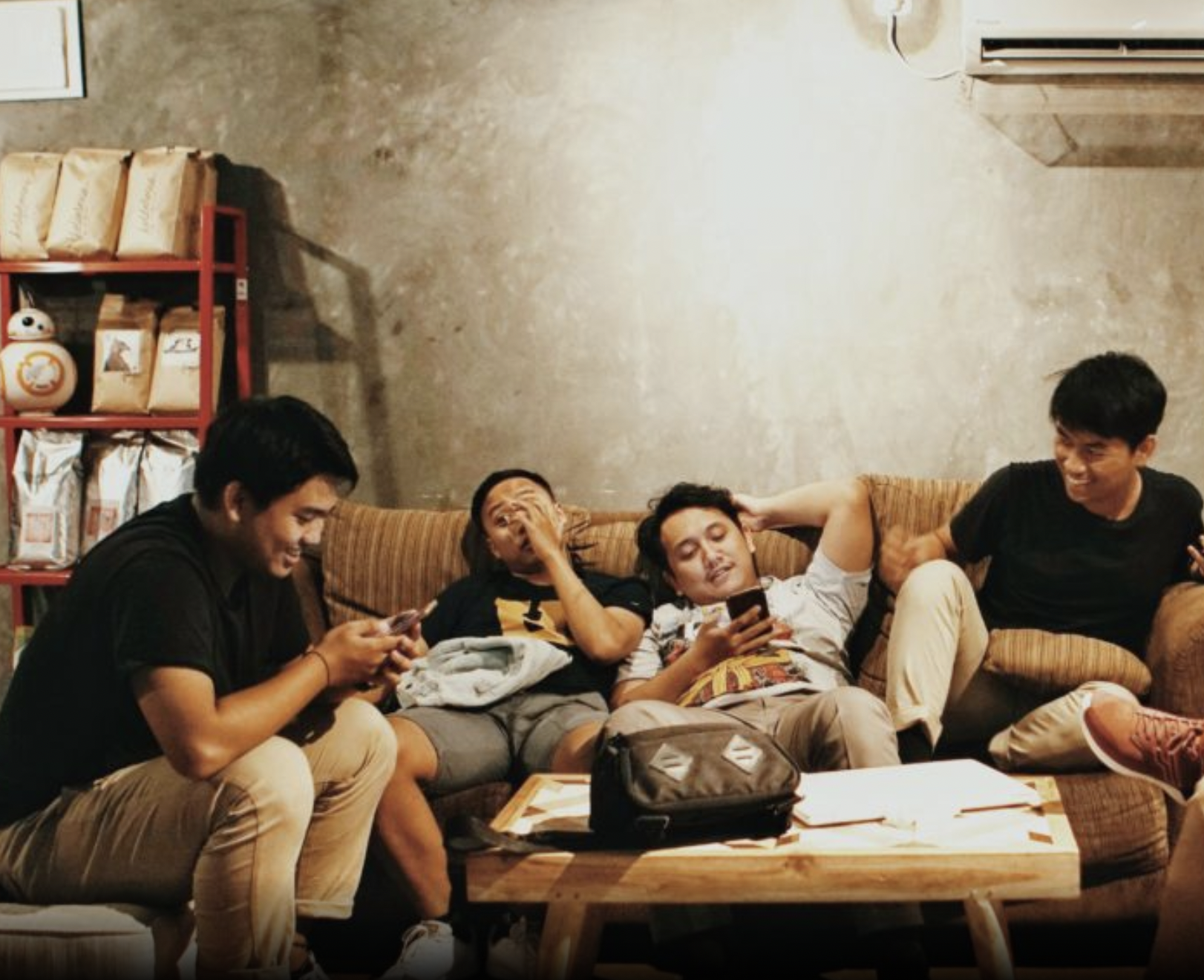
Rental harmony
Dividing both indivisible resources (rooms) and a divisible one (rent)
Can we do so fairly and efficiently?

Slide 8
Assign credit
Group divide up contributions to a project
Peer evaluation

Slide 9
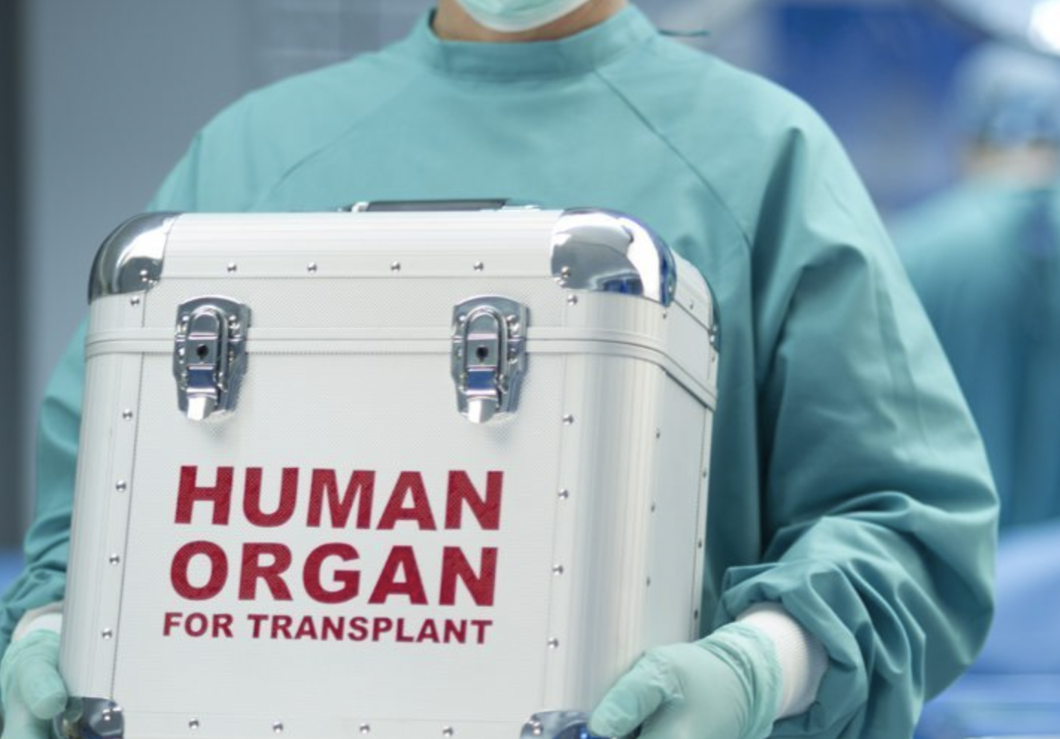
Organ matching
Indivisible resource
Two sided preferences

Slide 10
Roommate problem
Indivisible resource
Not bipartite

Slide 11
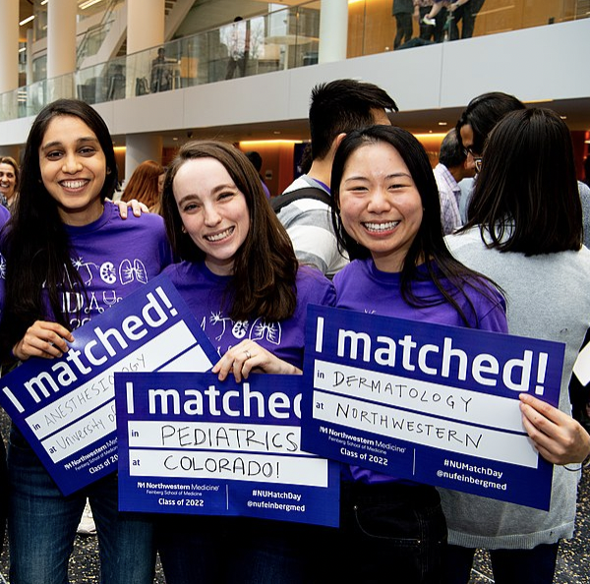
Resident matching
Doctors to hospitals
Again two sided market

Slide 12
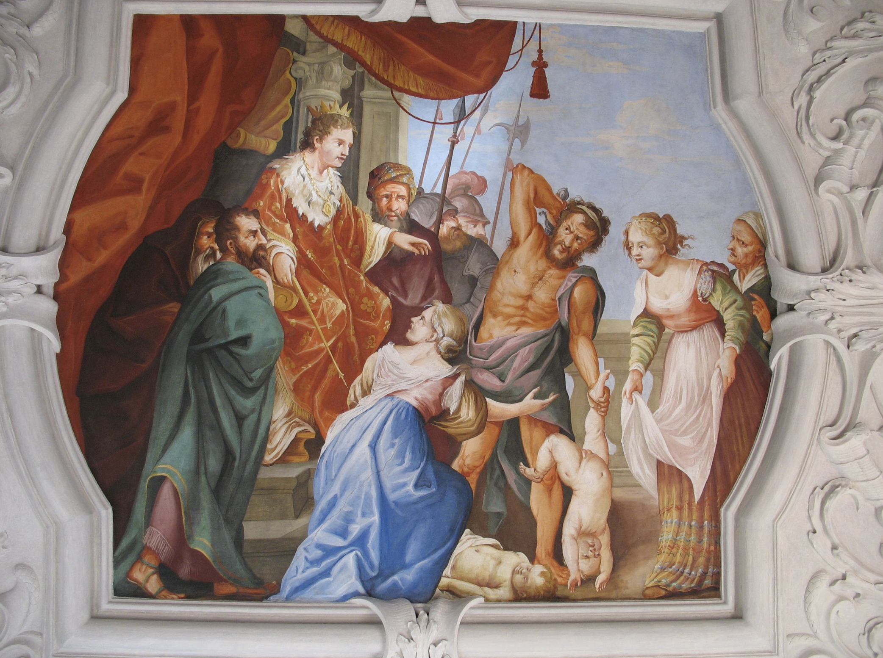
Long history
Early 1940’s Polish mathematicians
Hugo Steinhaus, Bronislaw Knaster and Stefan Banach
But can be traced back to biblical times
Abraham and Lot had to decide who got Canaan and who Jordan
Solomon had to decide which of two women was the mother of a disputed baby

Slide 13
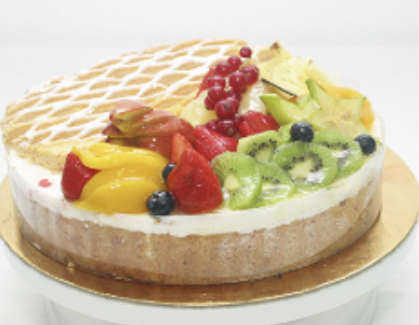
Fair division
Divisible / indivisible
Goods / chores
One sided / two sided preferences
Centralized / decentralized mechanism
One off/ repeated
Offline / online
Additive preferences / combinatorial, externalities
Entitlements
…

Slide 14
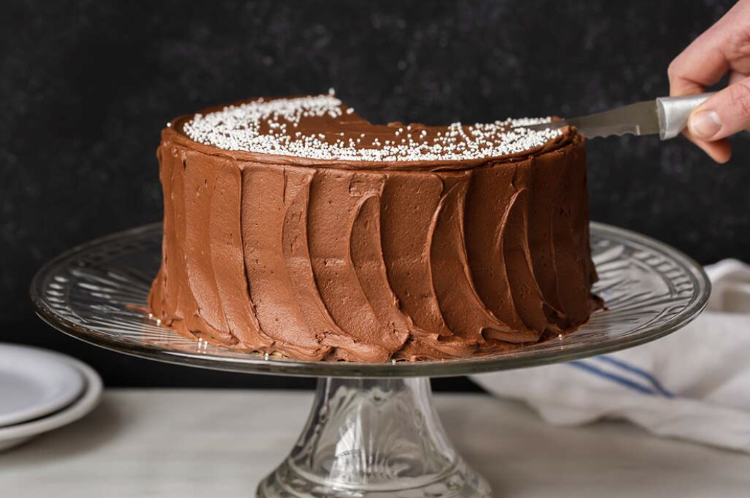
Divisible mechanisms
Cut n choose
How to extend to 3 or more agents?
Moving knife

Slide 15
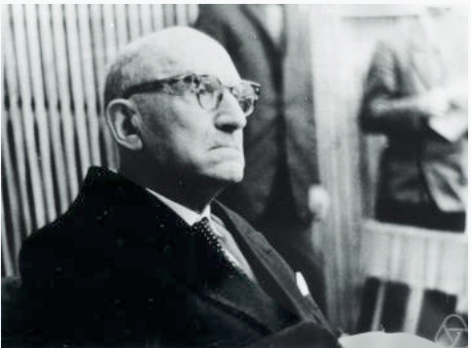
Divisible mechanisms
Knaster inheritance procedure
Each of n agents bid for item
Highest bidder ”pays” their bid into bank
Each then receives 1/n of their bid
Any surplus in bank divided equally

Slide 16
Indivisible mechanisms
Sequential allocation
Draft
Probablistic serial mechanism
AKA eating mechanism

Slide 17
What is fair?
Envy freeness
Not always possible in indivisible setting
Proportionality
Each agents gets at least 1/n of their total uiltiy
Equitable
Each agent gets the same utility

Slide 18
What is fair?
Maximin fair share
You divide into n bundles, you get at least utility of your worst bundle
Equal treatment of equals
Traces back to Aristotle
Anonymity
Names of agents doesn’t matter!

Slide 19
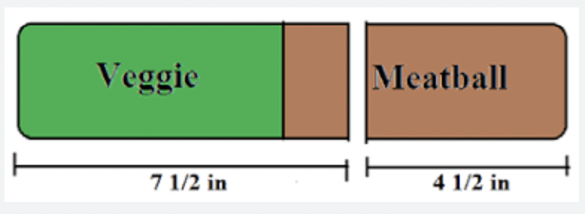
Other important normative properties
Pareto efficiency
Cannot change outcome and everyone agree it is better or the same
Strategy proofness
Agents have no incentive to misreport

Slide 20
Impossibility results
Like other areas of social choice, there are many impossibility results
THEOREM: No strategy proof mechanism for indivisible goods is envy-free

Slide 21
Impossibility results
Like other areas of social choice, there are many impossibility results
THEOREM: Unique envy-free outcome may be pareto dominated
A: 123456
B: 432156
C: 512634
Unique envy free outcome:
A: 13, B: 24, C: 56
Pareto dominated by
A: 12, B: 34, C: 56

Slide 22
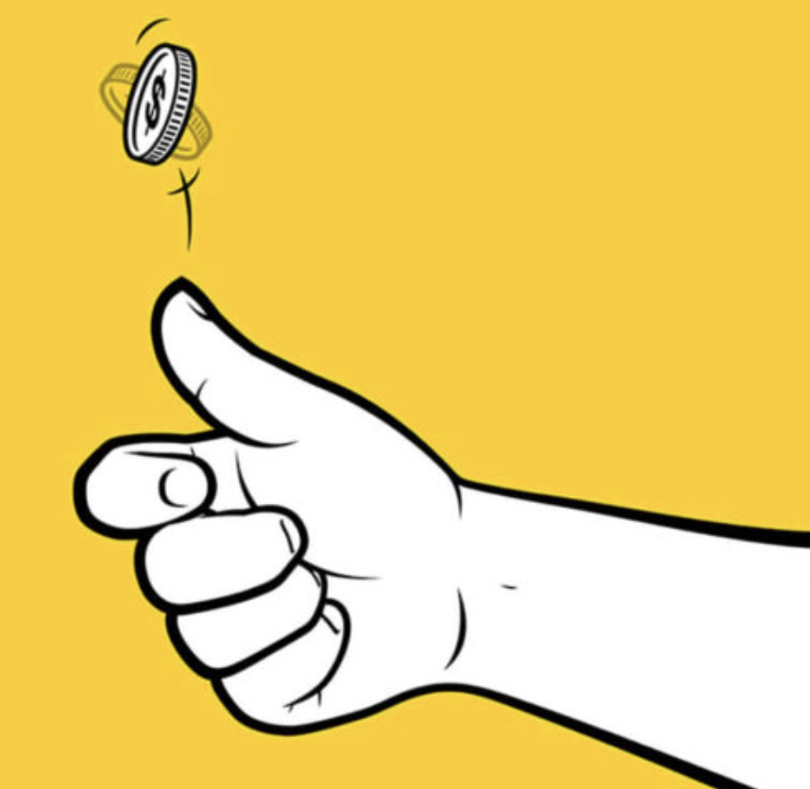
Overcoming impossibility
Randomization
Envy freeness impossible ex post
But can be achieved ex ante!

Slide 23
Overcoming impossibility
Approximation
Envy freeness impossible in general
Two agents like same item
But can achieve envy free up to one item (EF1)
Picking sequence:
1 2 3 4 1 2 3 4 ….

Slide 24
Dealing with strategic play
The DRAFT mechanism is not strategy proof
Captain1 can get a better team by picking players out of order
No need for Captian1 to pick early on a player that he likes but Captain2 dislikes
And vice versa

Slide 25
Strategic play
What is equilibrium behaviour?
Nash equilibrium: no captain can do better by deviating from this strategy
Subgame perfect Nash equilibrium: at each move of this repeated game, play Nash equilibrium

Slide 26
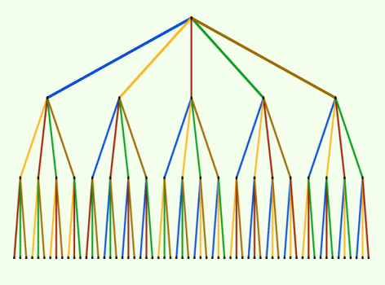
Strategic play
With 2 agents
There is unique subgame perfect Nash equilibrium
Challenge: there is an exponential number of possible partitions to consider!

Slide 27
Strategic play
With 2 agents
There is unique subgame perfect Nash equilibrium
It can be found in linear time
THM:
SPNE(P1,P2,policy) =
allocate(rev(P2),rev(P1), rev(policy))
Generalizes [Kohler and Chandraesekaran (1971)] who prove this for alternating policy

Slide 28
Strategic play
With 2 agents
There is unique subgame perfect Nash equilibrium
It can be found in linear time
And optimal policy remains alternating
THM: Alternating policy maximizes the expected sum of utilities supposing Borda scoring and agents acting strategically

Slide 29
Strategic play
With 3 agents
There can be an exponential number of subgame perfect Nash equilibrium
Open question
Complexity of computing one of them

Slide 30
Strategic play
With 3 agents
There can be an exponential number of subgame perfect Nash equilibrium
Open question
Complexity of computing one of them
Tractable case
If m of the items are equally valued, and k are valued differently
(n=m+k) then we can find a SPNE in k!m^{k+1} steps

Slide 31
Strategic play
With k agents
There can be an exponential number of subgame perfect Nash equilibrium
THM: Computing one of the SPNE is PSPACE-hard

Slide 32
Conclusions
Fair division is a fundamental and rich problem in social choice
Lots of normative and computational challenges in designing fair division mechanisms
Standard tools of computer scientist are relevant
Approximation
Computational complexity
….

Slide 33
